Slide 1
Module 3 Challenge Lab - Creating a Static Website for the Cafe
Made for Professor Lanham A. by Amrit Singh

Slide 2
AGENDA
Accessing the AWS management console
Task 1: Extracting the files that you need for this lab
Task 2: Creating an S3 bucket to host your static website
Task 3: Uploading content to your S3 bucket
Task 4: Creating a bucket policy to grant public read access
Task 5: Enabling versioning on the S3 bucket
Task 6: Setting lifecycle policies
Task 7: Enabling cross-Region replication

Slide 3
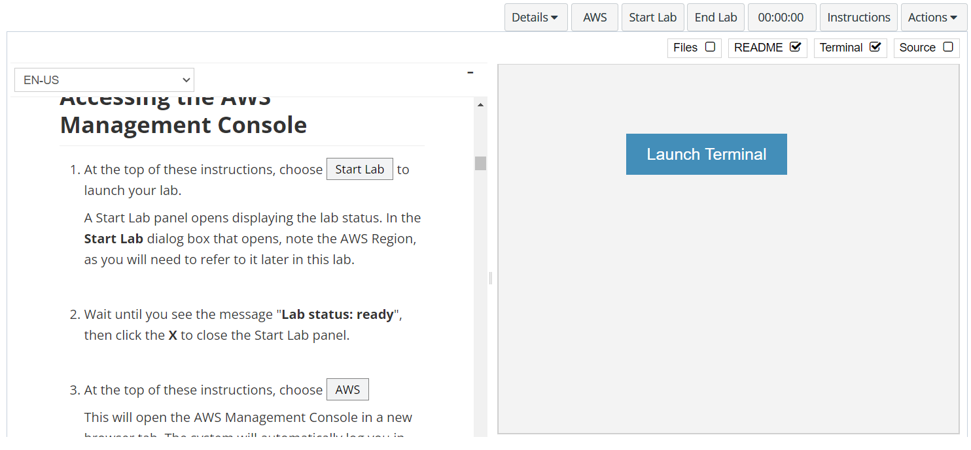
In aws labs click on start lab

Slide 4
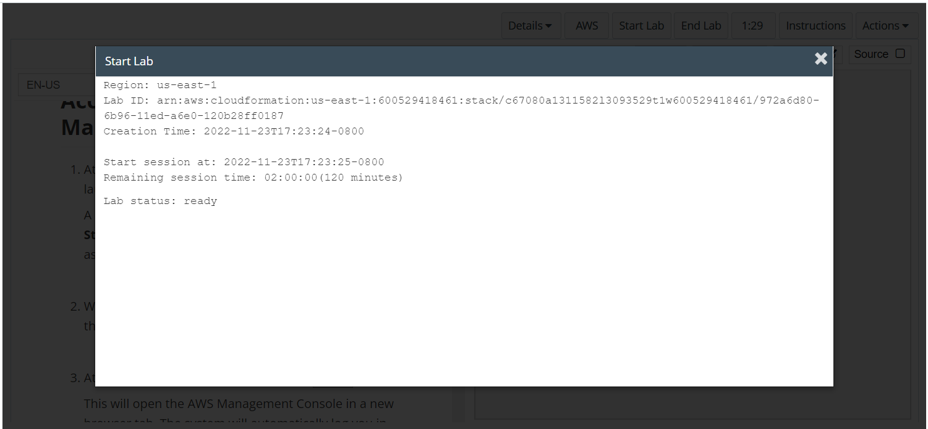
Wait to see lab ready status in the window then press x and click on aws to launch console

Slide 5
Task 1: Extracting the files that you need for this lab

Slide 6
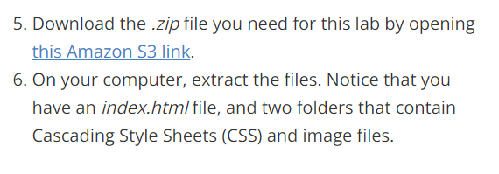
Download the files from aws labs by clicking on the link and extract the files
Click on the link

Slide 7
Task 2: Creating an S3 bucket to host your static website

Slide 8
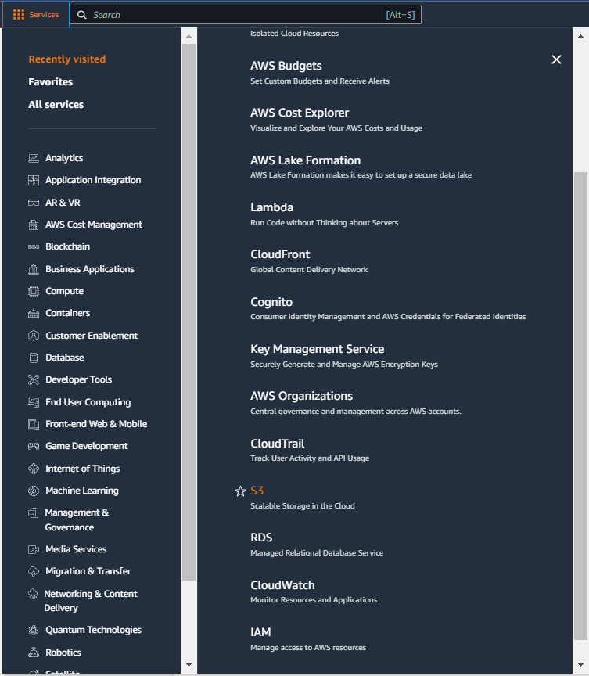
Select services and then click on S3 button
Click on the Services button
Click on the S3 button

Slide 9
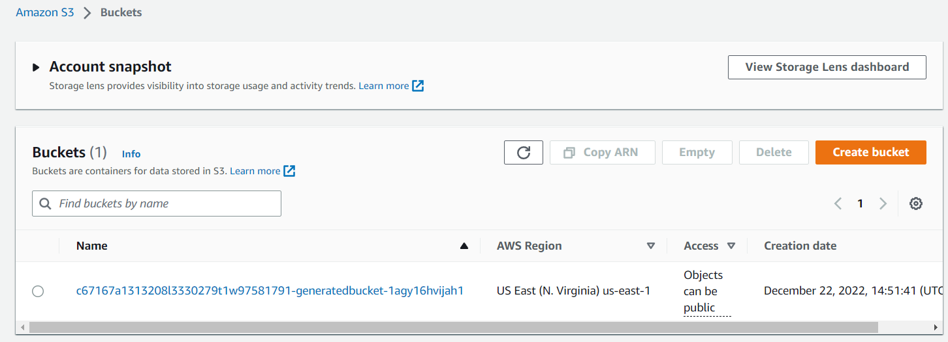
Click on create bucket button
Click on create bucket button

Slide 10
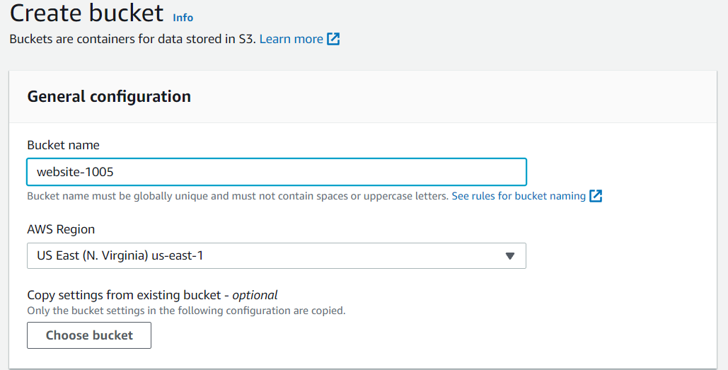
Set the bucket name and aws region

Slide 11
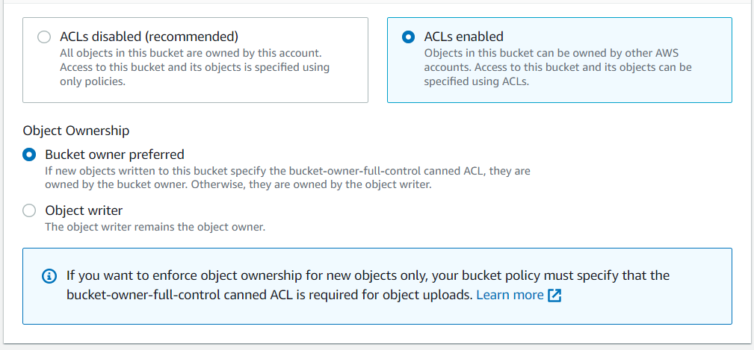
select acl enabled setting and choose bucket owner preferred

Slide 12
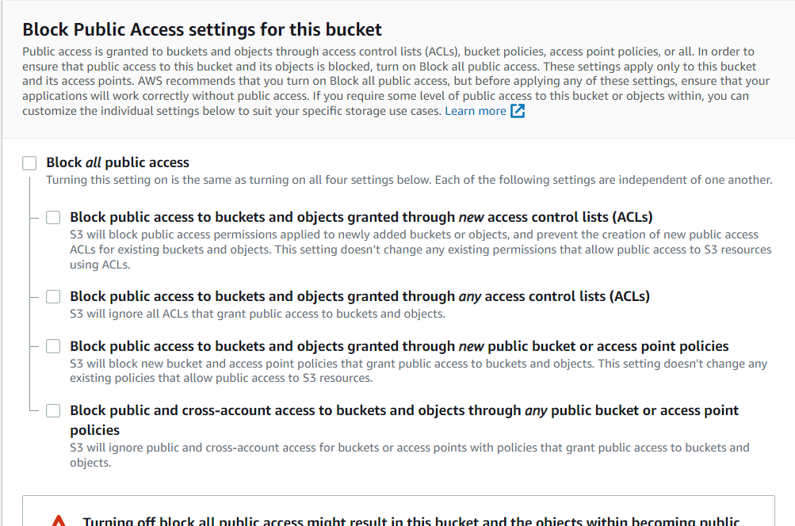
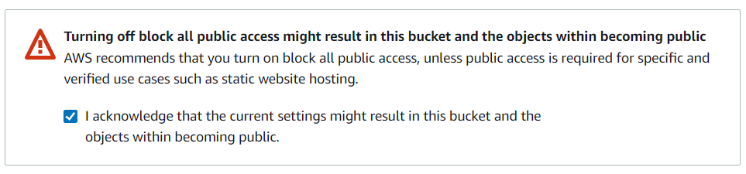
Uncheck block public access setting and acknowledge the settings and then click create bucket

Slide 13
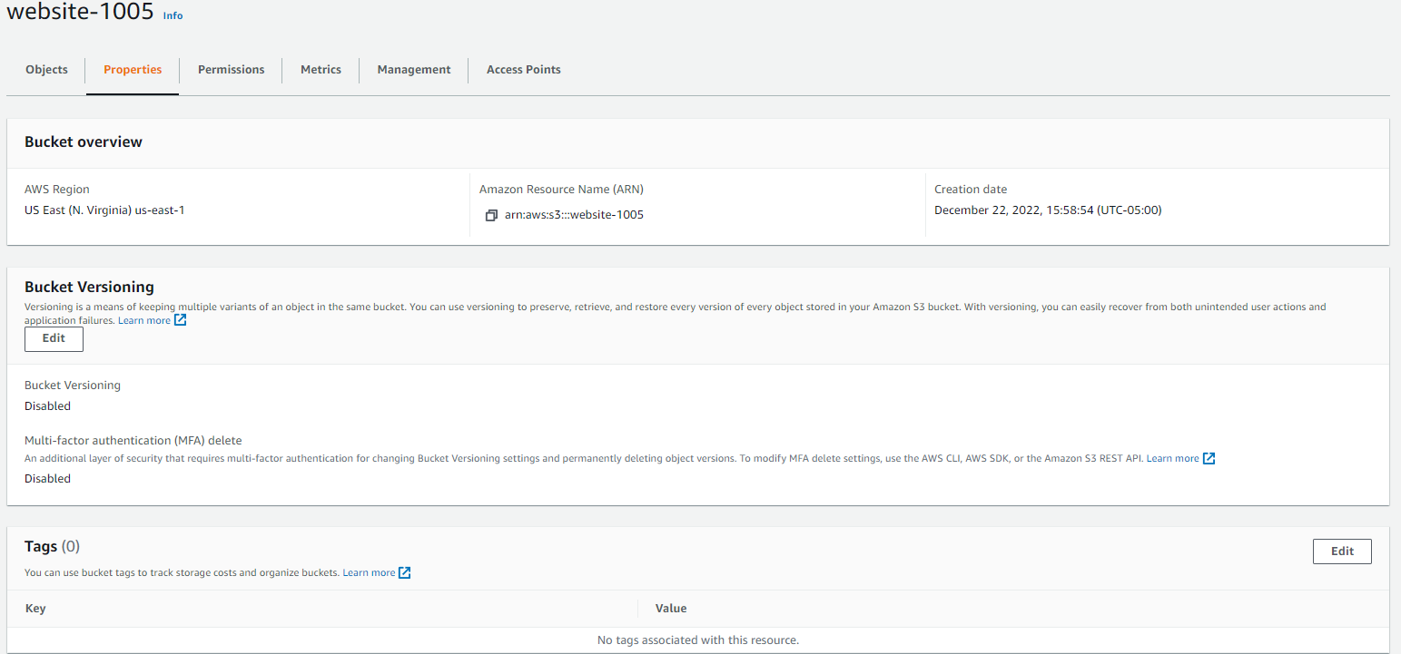
Choose the bucket and then select properties and then click on edit tags
Click on Edit

Slide 14
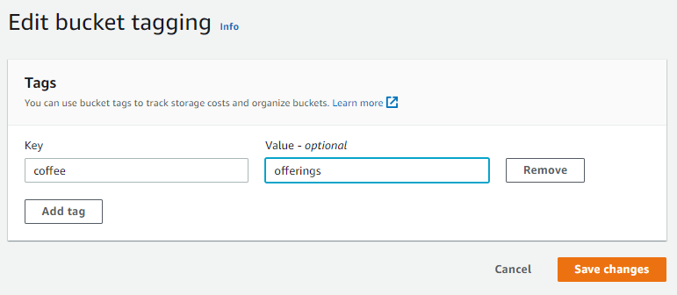
Click on add tags with key – Department and value – marketing and then save changes

Slide 15
In properties on Static website hosting click on edit button

Slide 16
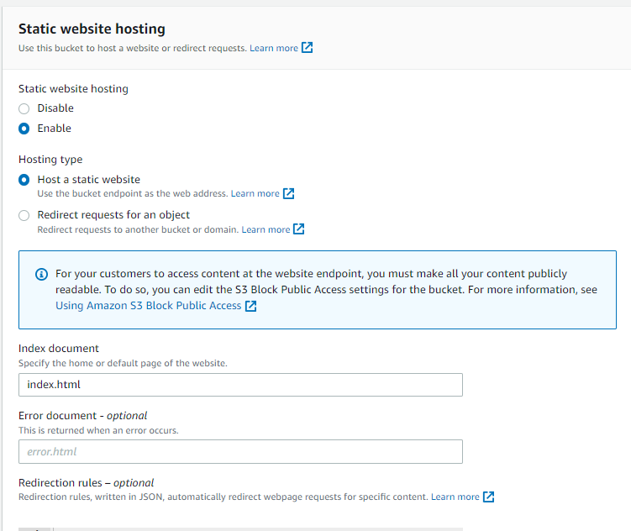
Update the relevant details in the static website hosting as per the screenshot and then click on save changes

Slide 17
Task 3 : Enabling access to the objects

Slide 18
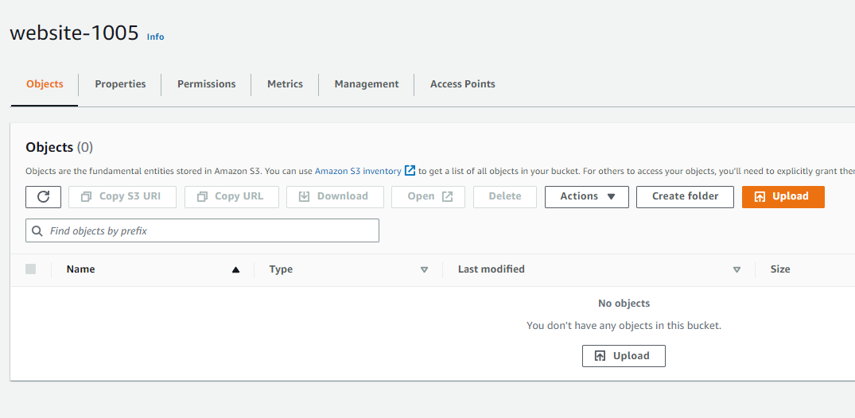
Under the bucket settings in objects click on upload button

Slide 19
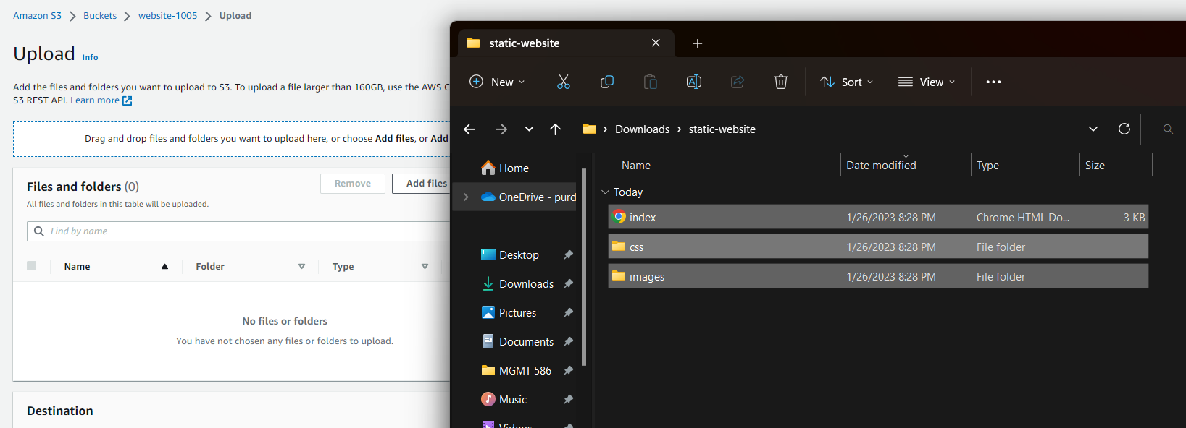
Drag and drop the files and folders in the upload box and click upload

Slide 20
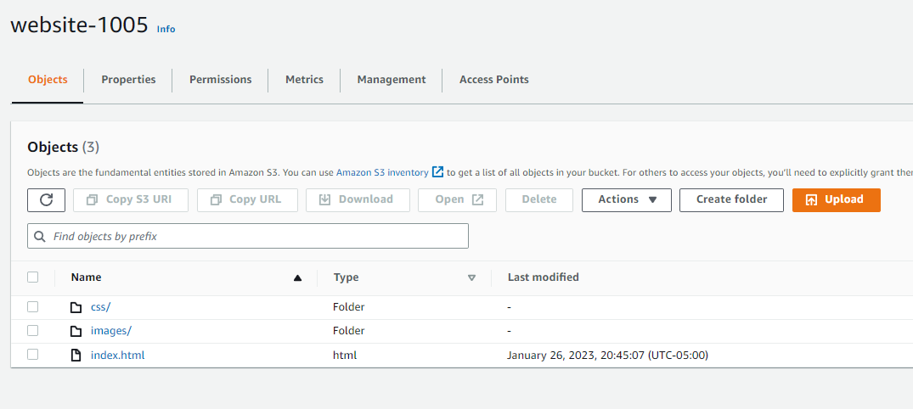
Folder should look like this after uploading

Slide 21
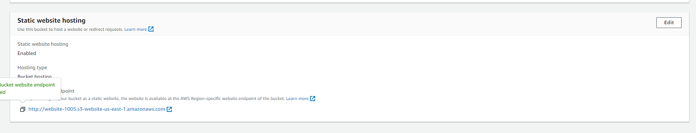
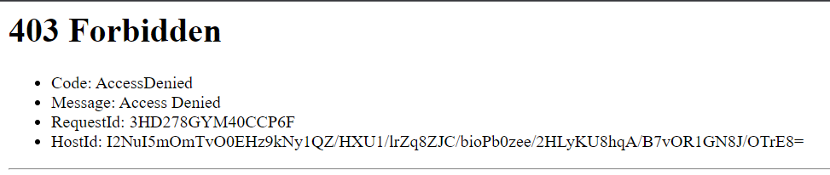
Copy the static website endpoint in the browser but error 404 would come up because of bucket permissions

Slide 22
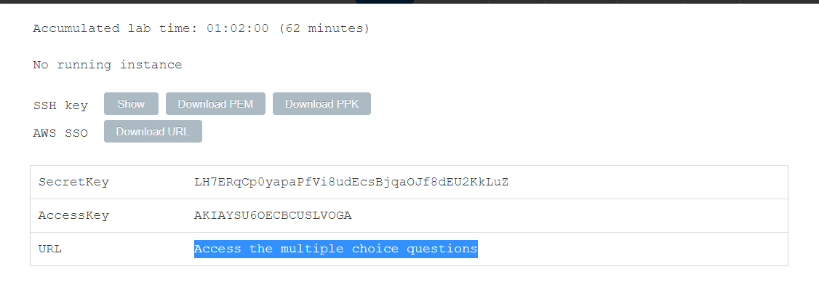
In the aws labs page click on details > aws: show> Access the multiple choice questions

Slide 23
Task 4: Creating a bucket policy to grant public read access

Slide 24
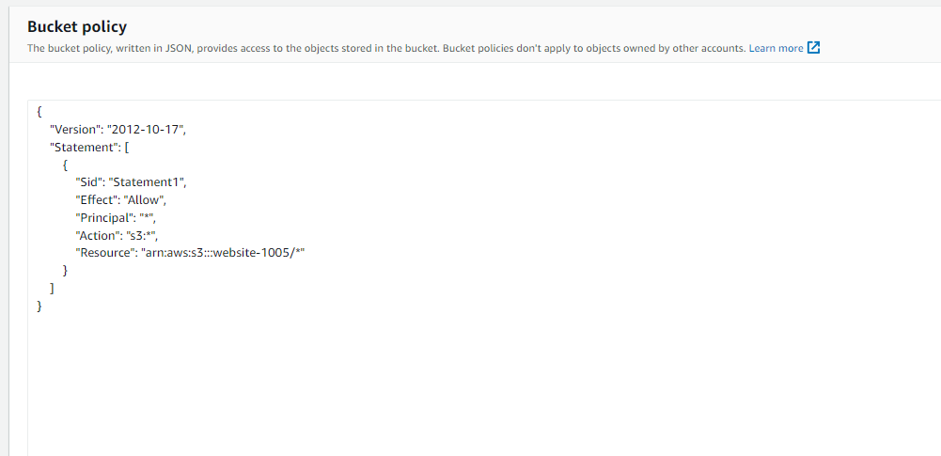
Add a bucket policy to make objects accessible via internet

Slide 25
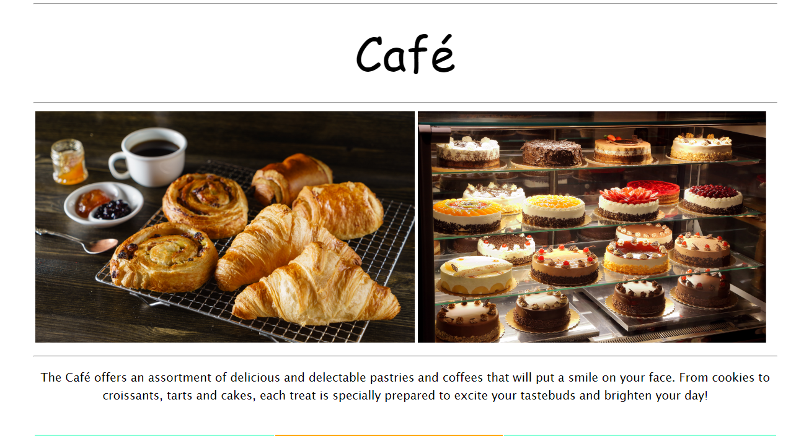
On refreshing the webpage again we can see that the page loads up

Slide 26
Task 5: Enabling versioning on the S3 bucket

Slide 27
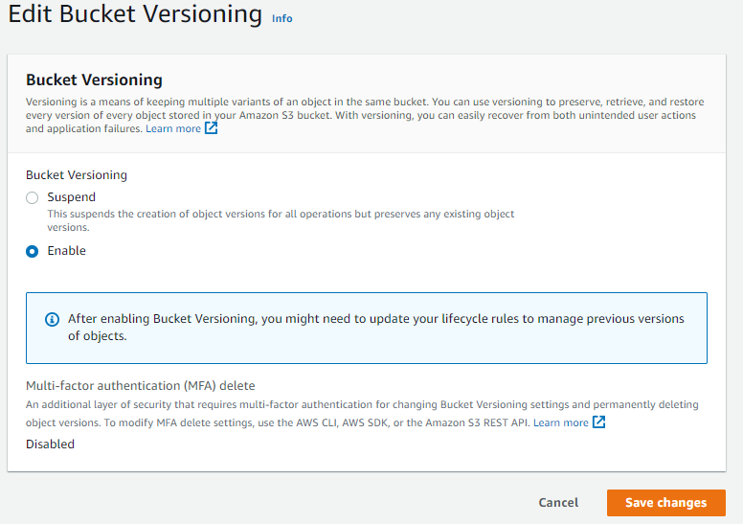
In s3 bucket enable bucket versioning under properties

Slide 28
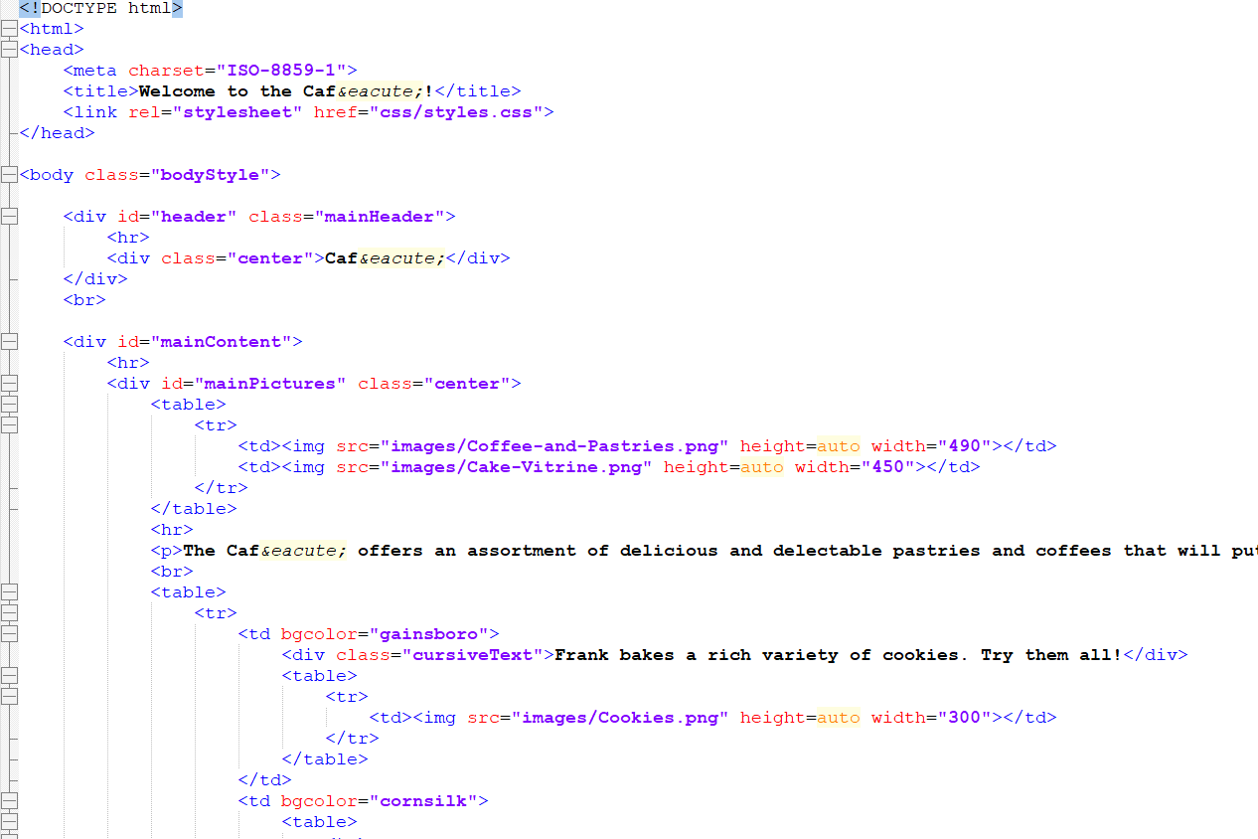
Open index.html file in notepad++ and make the changes as mentioned in aws labs

Slide 29
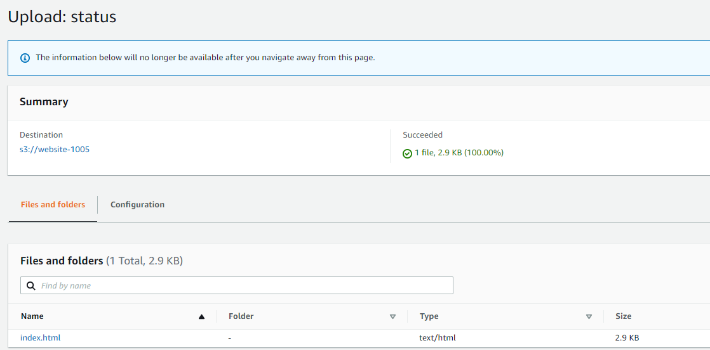
UPLOAD THE NEW INDEX.HTML FILE

Slide 30
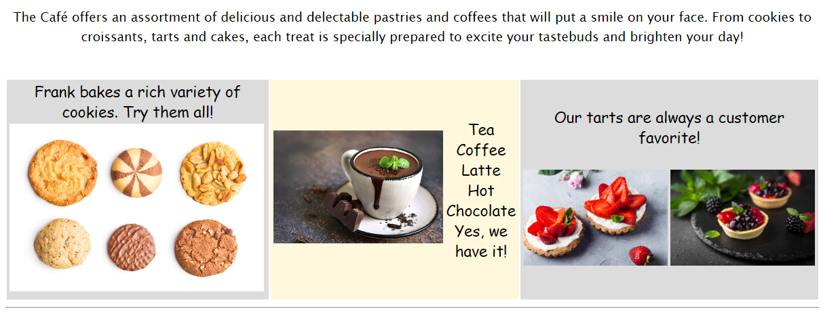
Reload index.html in the browser to see the updated background colors

Slide 31
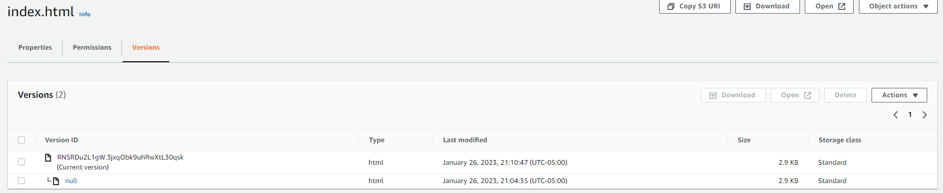
In the s3 click on index.html and select versions to see version history, next answer the multiple choice question in the browser that was previously opened

Slide 32
Task 6: Setting lifecycle policies

Slide 33
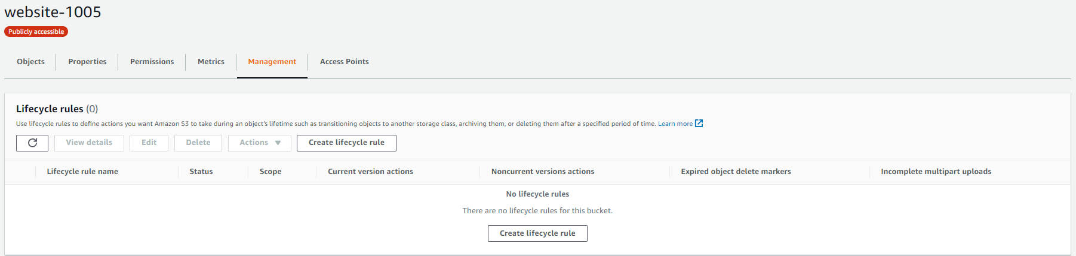
To create lifecycle rule select the bucket and go to management > create lifecycle rule

Slide 34
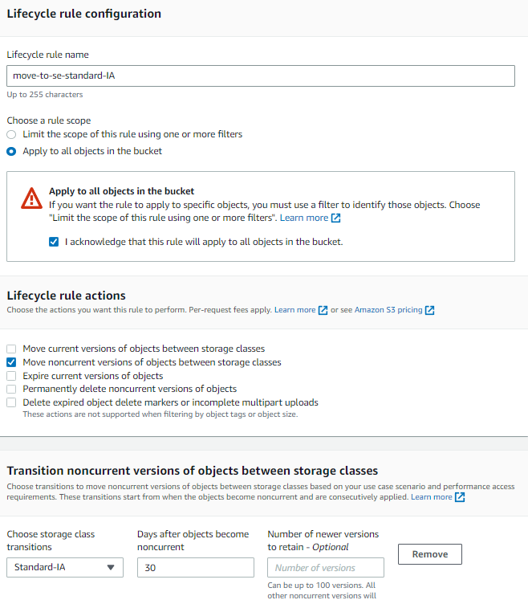
For first part create a lifecycle rule to move the objects in the bucket for noncurrent version after 30 days

Slide 35
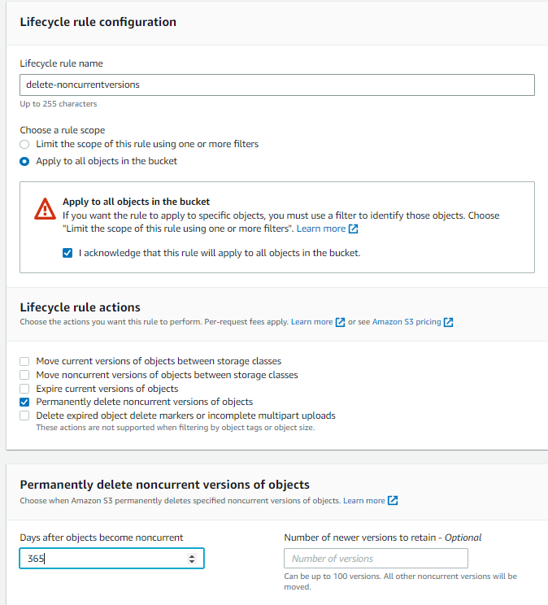
Create another rule to delete the non current versions after 365 days and click create rule

Slide 36
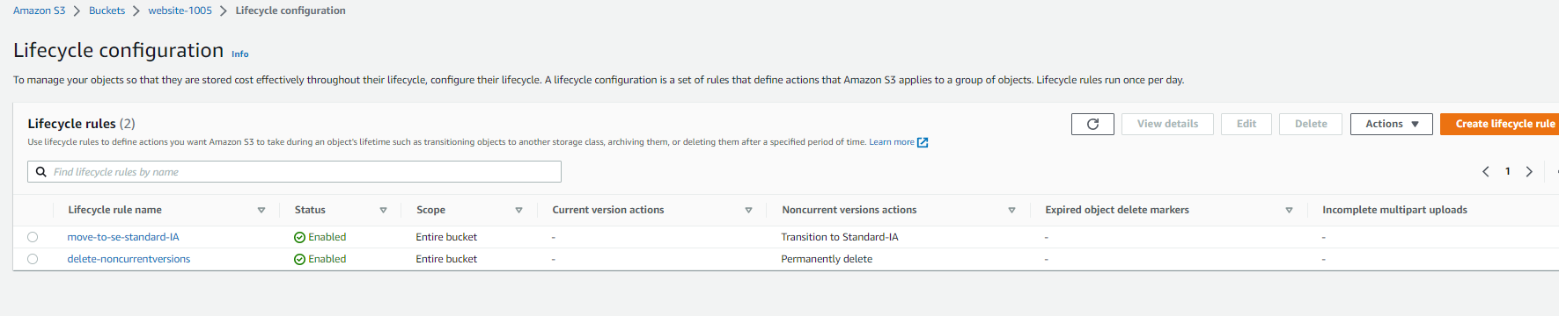
You should see 2 lifecycle rules now

Slide 37
Task 7: Enabling cross-Region replication

Slide 38
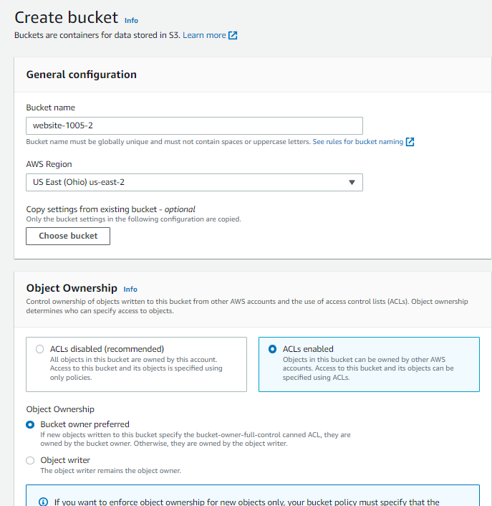
Create a new bucket in a different region

Slide 39
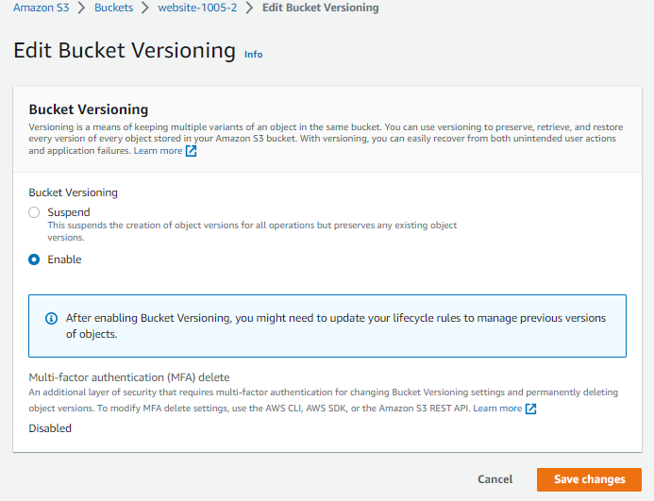
Enable versioning on the new bucket

Slide 40
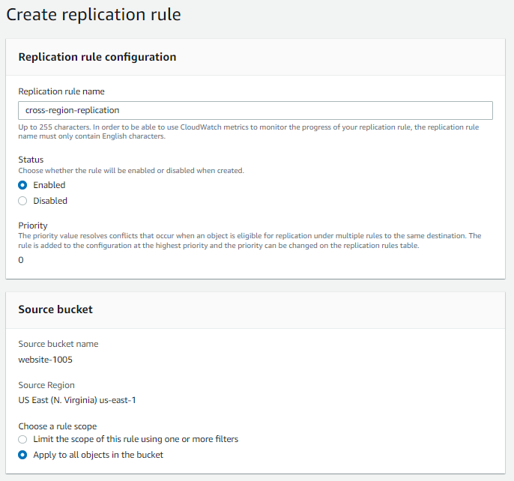
Create replication rule as shown - 1

Slide 41
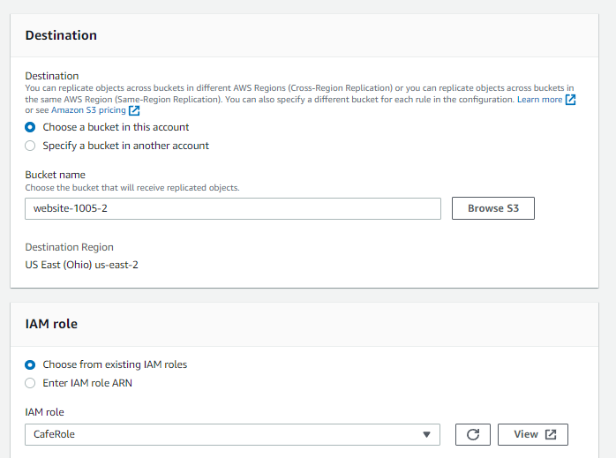
Create replication rule as shown-2

Slide 42
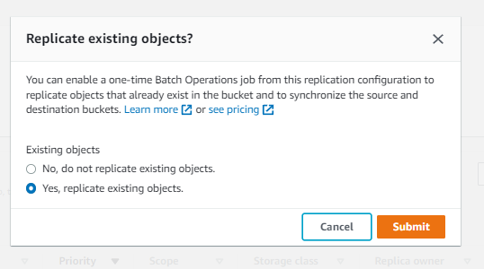
Replace existing objects

Slide 43
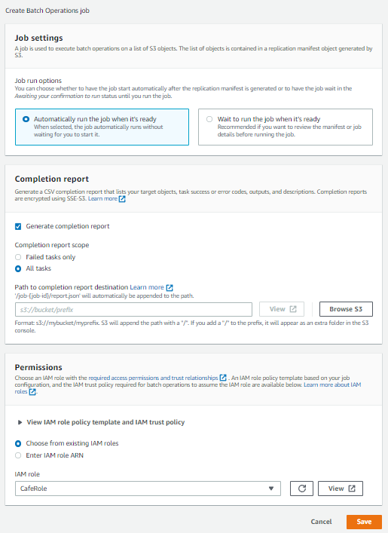
Update the job settings

Slide 44
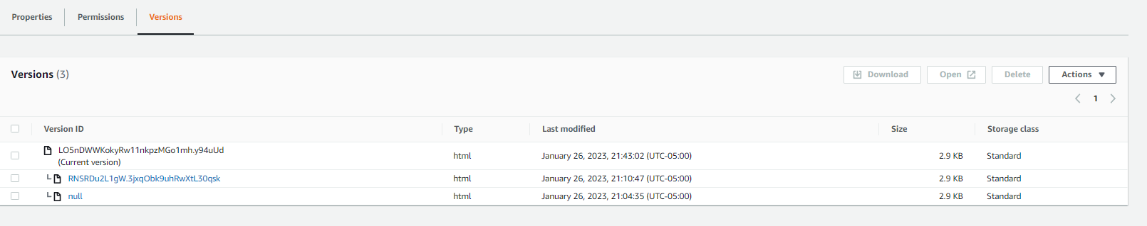
Make minor changes to the index file and upload to the source bucket, you can see 3 version of it now

Slide 45
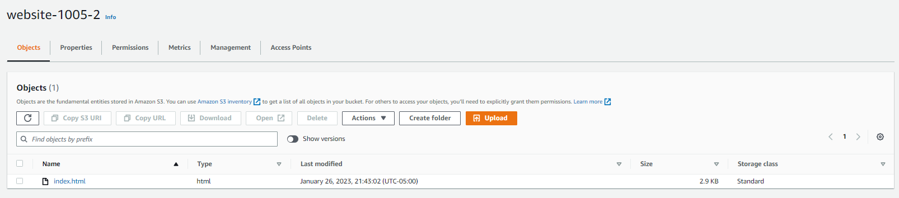
The file was also replicated in the destination bucket

Slide 46
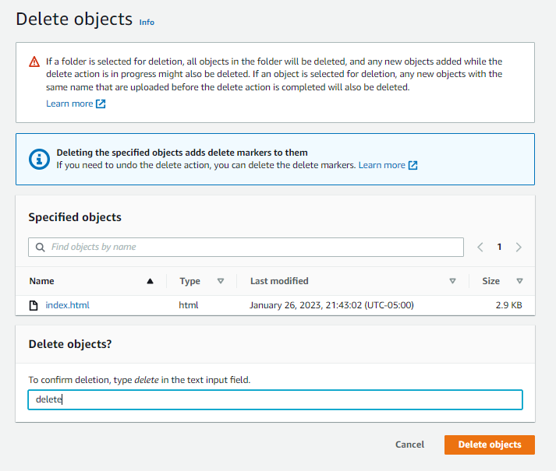
Delete the file from source bucket

Slide 47
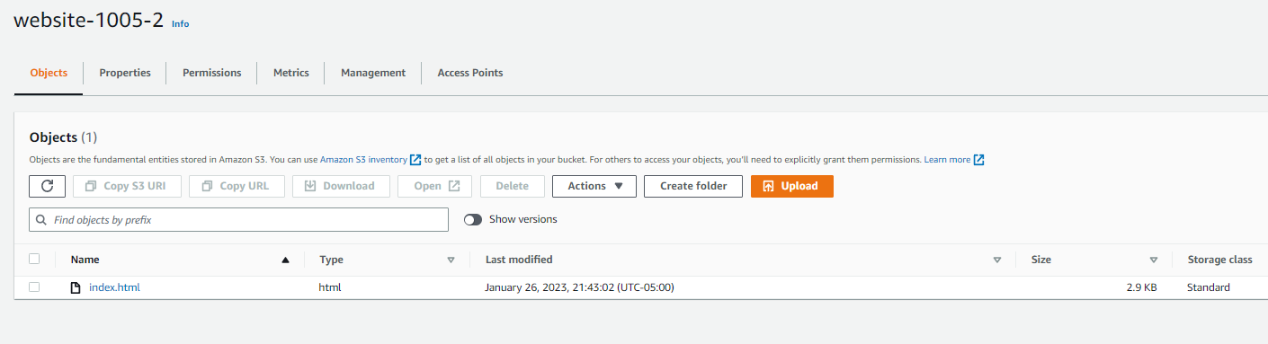
Check in the destination bucket to see what happens

Slide 48
THANK YOU
Amrit Singh

